Slide 1
MCS 8302
CNS 2205
Network Programming
DHCP, DNS

Slide 2
DHCP
Definition of DHCP (Dynamic Host Configuration Protocol):
  DHCP is a network protocol used to automatically assign and manage IP addresses, subnet masks, default gateways, DNS servers, and other network configuration parameters to devices on a network.

Slide 3
Introduction
Definition of DHCP (Dynamic Host Configuration Protocol):
  DHCP is a network protocol used to automatically assign and manage IP addresses, subnet masks, default gateways, DNS servers, and other network configuration parameters to devices on a network.
  It operates on the client-server model, where DHCP servers manage and allocate IP addresses to clients dynamically.
Purpose and Importance of DHCP:
  Simplifies IP address management: DHCP automates the process of IP address assignment, reducing the manual effort required to configure devices.
  Efficient resource utilization: It optimizes IP address usage by dynamically allocating and deallocating addresses as needed, minimizing IP conflicts.
  Centralized configuration: DHCP allows for centralized management of network configurations, making it easier to update and maintain consistent settings across the network.
  Scalability: DHCP scales well for networks with varying numbers of devices, providing a flexible solution for networks of different sizes.

Slide 4
Introduction
DHCP Workflow:
  Client requests an IP address from the DHCP server using DHCPDISCOVER message.
  DHCP server responds with a DHCPOFFER message, proposing an IP address and other configuration parameters.
  Client requests the offered IP address by sending a DHCPREQUEST message.
  DHCP server acknowledges the request with a DHCPACK message, confirming the IP address lease.
  The client uses the leased IP address for a specified duration (lease time), after which it may request a renewal.
Key Components:
  DHCP Server: Manages and assigns IP addresses and configuration parameters to clients.
  DHCP Client: Device requesting an IP address and network configuration from the DHCP server.
  DHCP Relay Agent: Forwards DHCP messages between clients and DHCP servers in different network segments.

Slide 5
Introduction
Scenarios for DHCP Usage:
  Home networks: Easily connect multiple devices to the internet without manual IP configuration.
  Corporate networks: Efficiently manage IP addresses for a large number of workstations, servers, and other devices.
  Public Wi-Fi hotspots: Provide internet connectivity to users with minimal configuration efforts.
  Virtualization environments: Dynamically allocate IP addresses to virtual machines in data centers.

Slide 6
ISC DHCP Server
Internet Systems Consortium DHCP:
  ISC DHCP is an open-source DHCP server implementation provided by the Internet Systems Consortium (ISC).
  It is a widely used DHCP server software, known for its reliability, flexibility, and robust feature set.
  ISC DHCP supports both IPv4 and IPv6 configurations, making it versatile for various network setups.

Slide 7
ISC DHCP Server
Internet Systems Consortium DHCP:
  ISC DHCP is an open-source DHCP server implementation provided by the Internet Systems Consortium (ISC).
  It is a widely used DHCP server software, known for its reliability, flexibility, and robust feature set.
  ISC DHCP supports both IPv4 and IPv6 configurations, making it versatile for various network setups.
Features and Capabilities:
  Dynamic IP Address Allocation: ISC DHCP dynamically allocates and manages IP addresses for clients, allowing efficient use of available address space.
  Configuration Flexibility: Provides extensive configuration options through the dhcpd.conf file, allowing fine-grained control over DHCP behavior.
  Subnet Management: Enables segmentation of the network into subnets and efficient management of IP address pools within each subnet.
  Lease Management: Allows setting lease durations for IP addresses, determining how long a client can use an assigned IP address.
  Failover Support: Supports failover configurations for high availability, ensuring uninterrupted DHCP services even in case of server failures.

Slide 8
ISC DHCP Server
Use Cases:
  Enterprise Networks: Ideal for managing IP addresses in large corporate networks with numerous devices, ensuring organized and efficient IP assignment.
  Service Providers: Useful for internet service providers (ISPs) to manage IP addresses for their subscribers and customers, optimizing resource allocation.
  Educational Institutions: Effective for managing IP addresses in schools, colleges, and universities, providing seamless connectivity to students and staff.
  Public and Private Networks: Suitable for both public and private networks, enabling automated IP address assignment in various environments.
Community and Support:
  ISC DHCP is supported by an active open-source community, providing assistance, documentation, and updates.
  Official documentation, forums, and community-contributed guides are available to help users effectively configure and utilize ISC DHCP.

Slide 9
Configuration Files
Default Configuration Files:
  The installation creates default configuration files:
    /etc/default/isc-dhcp-server: Configuration file to set options for the DHCP server daemon.
    /etc/dhcp/dhcpd.conf: Main configuration file for DHCP server settings.
Configuration File Locations:
  /etc/default/isc-dhcp-server:
    Contains environment variables that control the behavior of the DHCP server daemon, such as the network interfaces to listen on.
  /etc/dhcp/dhcpd.conf:
    Main configuration file where you define the DHCP server's behavior, including IP address ranges, options, and more.

Slide 10
Configuration Parameters in dhcpd.conf
Subnet Declaration:
  Defines a network segment and its associated subnet mask using the subnet declaration. Example: subnet 192.168.1.0 netmask 255.255.255.0 { ... }
IP Range Allocation:
  Specifies a range of IP addresses to be dynamically allocated to clients within a subnet. Example: range 192.168.1.100 192.168.1.200;
Lease Duration:
  Determines how long a client can hold a particular IP address. Set using default-lease-time (initial lease) and max-lease-time (maximum lease). Example: default-lease-time 600; max-lease-time 7200;
DNS Configuration:
  Provides DNS server(s) to clients for name resolution. Use option domain-name-servers. Example: option domain-name-servers 8.8.8.8, 8.8.4.4;
Default Gateway:
  Specifies the default gateway (router) for clients. Set using option routers. Example: option routers 192.168.1.1;

Slide 11
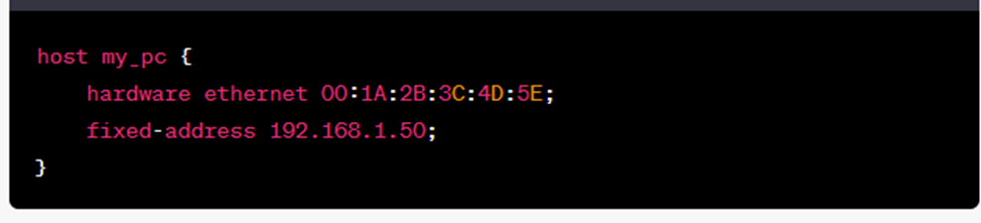
Configuration Parameters in dhcpd.conf
Host Reservations:
  Assigns specific IP addresses to clients based on MAC addresses. Example:
Advanced Configurations:
  Additional configurations like options, classes, and subclasses can be defined for more granular control over DHCP behavior.
Comments and Syntax:
  Use # to add comments in the configuration file for explanatory notes.
  Ensure proper syntax and structure adherence to avoid configuration errors.

Slide 12
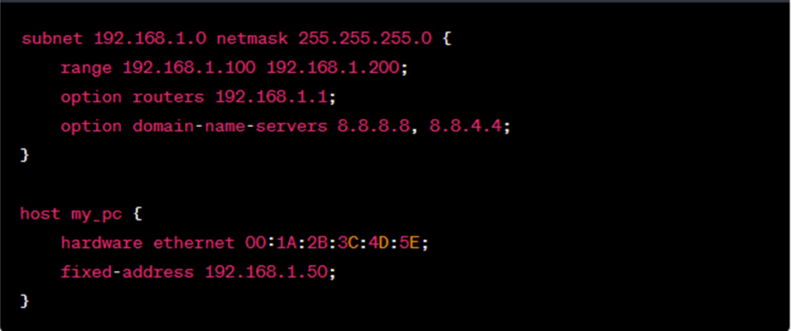
Example DHCP Configuration
Explanation:
  Defines a subnet with a range of IP addresses (192.168.1.100 to 192.168.1.200).
  Sets the default gateway (router) to 192.168.1.1.
  Provides DNS server addresses (Google DNS) to clients for name resolution.
  Reserves IP address 192.168.1.50 for a host with a specific MAC address.

Slide 13
Monitoring DHCP Server
Monitoring Tools:
  systemctl:
    Use systemctl to view the status of the DHCP server:
      sudo systemctl status isc-dhcp-server displays the server's status, including whether it's active, its PID, and recent logs.
Log Monitoring:
  Monitor the DHCP server logs in real-time using the tail command:
    sudo tail -f /var/log/syslog provides a continuous display of new entries in the syslog, including DHCP-related events.
Logs Location:
  DHCP server logs are typically stored in /var/log/syslog or /var/log/messages.

Slide 14
DHCP Scope Exhaustion
Definition:
  DHCP scope exhaustion refers to a situation where a DHCP server has depleted its available pool of IP addresses to assign to clients within a given subnet or scope.
Causes:
  Inadequate Address Range:
    Allocating a limited range of IP addresses for a large number of clients can lead to exhaustion.
  Long Lease Durations:
    Extended lease durations can tie up addresses for a long time, limiting availability for new clients.
  Connected Devices:
    Rogue DHCP clients – Scope exhaustion attacks
    Statically assigned IPs can consume addresses without proper tracking.

Slide 15
DNS

Slide 16
Introduction
Definition of DNS:
  DNS, or Domain Name System, is a hierarchical and distributed naming system used to translate human-readable domain names into IP addresses (and vice versa) required for internet communication.
Purpose of DNS:
  DNS serves as the phone book of the internet, enabling users to access websites, send emails, and connect to various online services using easily memorable domain names instead of complex IP addresses.
How DNS Works:
  Clients send DNS queries to DNS servers (recursive resolver, authoritative, or root) to resolve domain names to IP addresses.
  The DNS query follows a series of recursive and iterative steps to find the correct IP address associated with the given domain name.

Slide 17
DNS Components
DNS Hierarchy:
  The DNS hierarchy is organized in a tree-like structure, where each node represents a domain. Domains are organized into levels, including the top-level domain (TLD), second-level domain, subdomains, and individual hostnames.
  Example: www.example.com consists of the subdomain www, the second-level domain example, and the top-level domain .com.
Root DNS Servers:
  The root DNS servers are a crucial component of the DNS infrastructure.
  There are 13 root DNS servers globally, each represented by a letter (A through M), and they are maintained by different organizations worldwide.
  These servers are responsible for directing queries to the appropriate TLD DNS servers based on the top-level domain requested.

Slide 18
DNS Components
TLDs (Top-Level Domains):
  TLDs are the highest level in the DNS hierarchy and are represented by domain extensions, such as .com, .org, .net, .gov, .edu, and country-code TLDs like .us, .uk, etc.
  Registry operators manage TLDs and are responsible for the administration and allocation of domain names within their respective TLDs.
Authoritative Name Servers:
  Authoritative name servers hold the actual DNS records for a specific domain or zone.
  When queried about a domain, these servers provide authoritative responses, containing the DNS records associated with the requested domain.
Recursive Resolvers:
  Recursive resolvers are DNS servers that act on behalf of clients to resolve domain names into IP addresses.
  They traverse the DNS hierarchy starting from the root servers, delegating queries to authoritative name servers, and collating the responses to provide the IP address to the requesting client.

Slide 19
DNS Record Types
A Record (Address Record):
  Explanation of A records, mapping domain names to IPv4 addresses.
AAAA Record (IPv6 Address Record):
  Explanation of AAAA records, mapping domain names to IPv6 addresses.
CNAME Record (Canonical Name):
  Explanation of CNAME records, aliasing one domain name to another.
MX Record (Mail Exchange):
  Explanation of MX records, specifying mail servers for a domain.
NS Record (Name Server):
  Explanation of NS records, specifying authoritative name servers for a domain.

Slide 20
BIND (Berkeley Internet Name Domain)
BIND (Berkeley Internet Name Domain):
  BIND is an open-source software that provides DNS functionality, developed by the Internet Systems Consortium (ISC).
  It is widely used for hosting and managing domain name systems on the internet.
  BIND offers features like domain name resolution, zone transfers, and DNSSEC (Domain Name System Security Extensions).
BIND in the DNS Infrastructure:
  BIND plays a critical role in the internet's infrastructure by acting as an authoritative name server.
  It resolves domain names to IP addresses, facilitating communication between devices using human-readable domain names.
  BIND supports the distributed and hierarchical structure of DNS, enhancing the reliability and efficiency of the internet.

Slide 21
BIND9 Configuration
Editing named.conf.options:
  Navigate to the named.conf.options file usually located at /etc/bind/named.conf.options.
  Configure the server's global options to tailor the BIND9 behavior based on your requirements.
  Example configuration options:
    listen-on port 53 { any; }; - Configures BIND9 to listen on all available network interfaces on port 53.
    forwarders { 8.8.8.8; 8.8.4.4; }; - Specifies DNS servers to forward queries if the current server can't resolve them locally.
    allow-recursion { localhost; localnets; }; - Restricts recursive queries to localhost and local networks.
    allow-query { any; }; - Permits queries from any IP address.

Slide 22
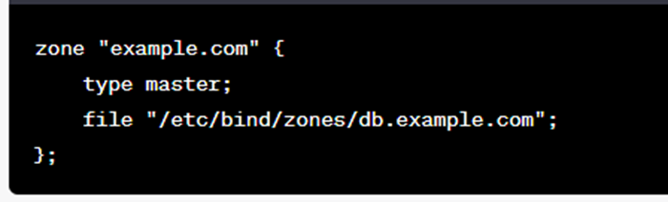
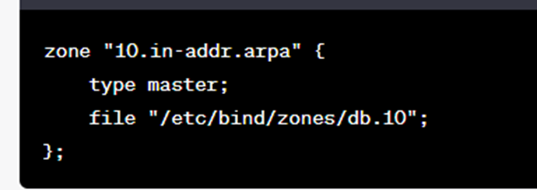
BIND9 Configuration
named.conf:
  Navigate to the named.conf.local file usually located at /etc/bind/named.conf.local.
  Define forward and reverse zones for your domains.
  Example forward zone configuration:
  Example reverse zone configuration:

